Slide 1
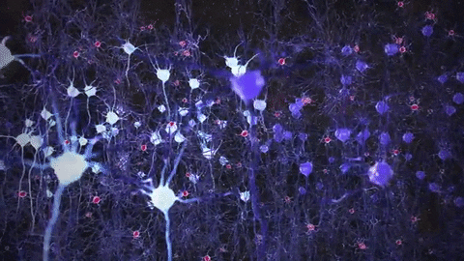
PREDICTION OF ALZHEIMERS DISEASE AND IT’S SEVERITY
A MULTICLASS-CLASSIFICATION PROBLEM
-KUSUMA KORADA.
GITHUB:https://github.com/kismiskorada/AD-CNN

Slide 2

TABLE OF CONTENTS
INTRODUCTION
DATA SET OVERVIEW
DATA LOADING
EXPLORATORY DATA ANALYSIS
DATA PRE-PROCESSING
BUILDING OF CNN MODEL
EVALUATION OF THE MODEL

Slide 3
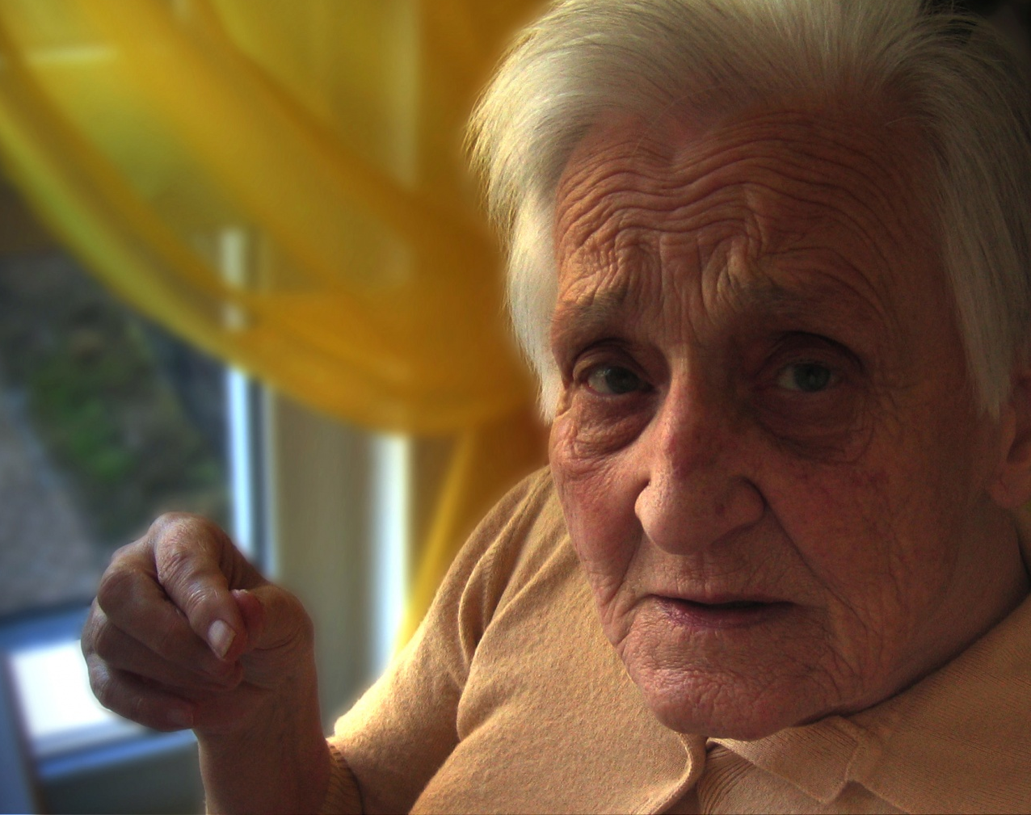
1.INTRODUCTION
Alzheimer's disease is a brain disorder that gets worse over time. It's characterized by changes in the brain that lead to deposits of certain proteins. Alzheimer's disease causes the brain to shrink and brain cells to eventually die.
The exact causes of Alzheimer's disease aren't fully understood. But at a basic level, brain proteins fail to function as usual. This disrupts the work of brain cells, also called neurons, and triggers a series of events. The neurons become damaged and lose connections to each other. They eventually die.

Slide 4
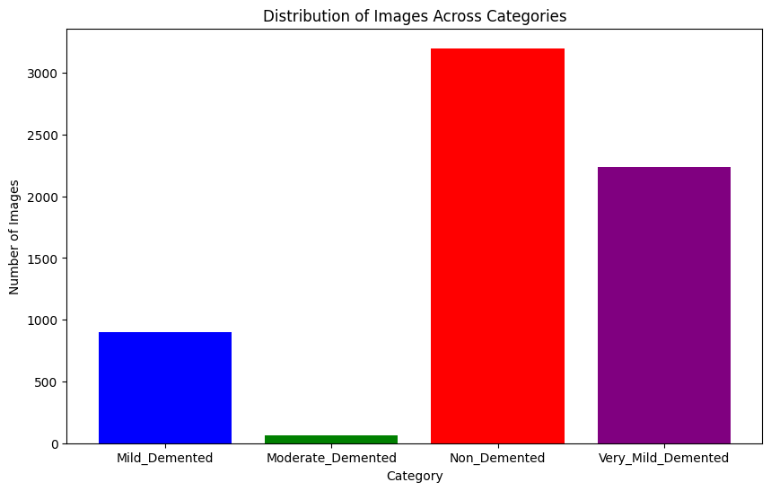
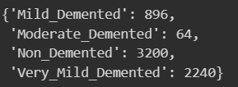
2.DATA SET OVERVIEW
The Data set is taken from Kaggle
The Dataset has four files .
Total 6400 MRI images are present.
Data set link:https://www.kaggle.com/datasets/kumarln/alzheimers-disease-dataset
We can observe that Moderate_Demented has very few images showing significant class imbalance.

Slide 5

LIBRARIES
Os
Zipfile
Numpy
CV2
Tensorflow
Matplotlib
sklearn (scikit-learn)
Keras
imblearn

Slide 6
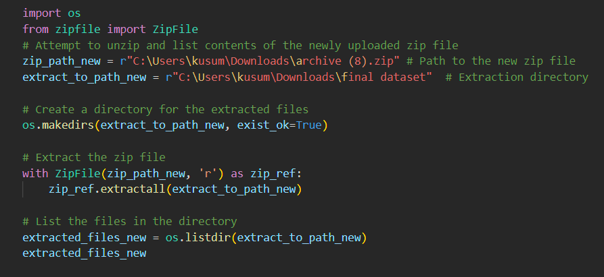
It uses the ‘zipfile’ module to handle the extraction and os module to interact with the file system, such as making the new directory if it doesn't already exist.
The contents of a zip file named archive (8).zip into a directory named final dataset

Slide 7
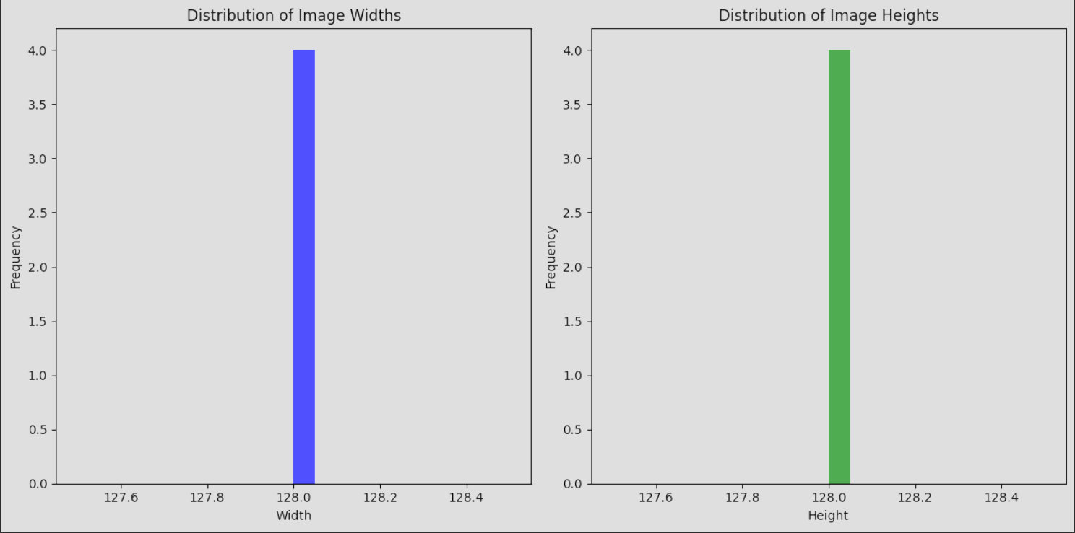
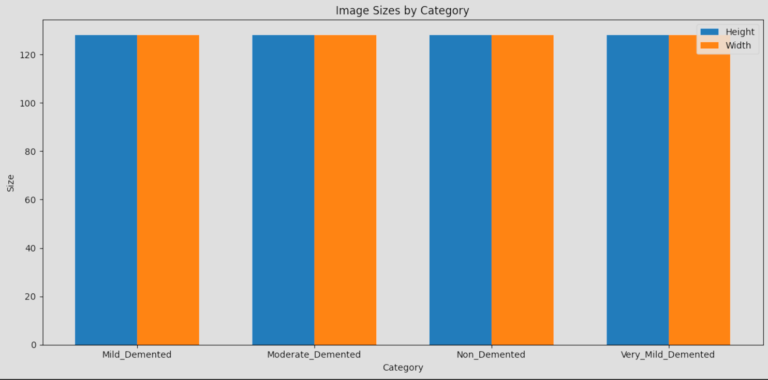
EXPLORATORY DATA ANALYSIS
7
Histograms are plotted to represent the image size . All images have almost the same size around 128 units

Slide 8
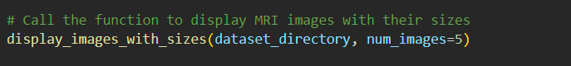
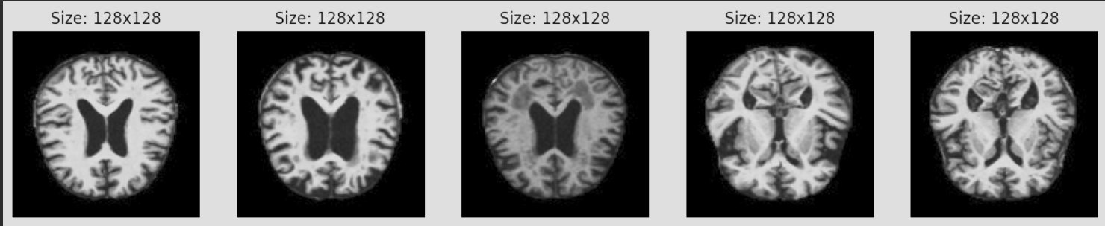
Grayscale Format: The images appear to be in grayscale, which suggests that color information is not necessary for the analysis, reducing the computational complexity.
The images appear to be well-centered and focused on the region of interest, which could mean they've been cropped or segmented to exclude irrelevant parts of the scans, focusing the model on the most informative areas.
8

Slide 9

DATA PRE-PROCESSING
1.APPLYING CONTOUR SHARPENING
01
2. CONTRAST ENHANCING USING CLAHE
02
3.NOISE REDUCTION USING GUASSIAN BLUR FILTERING
03
4.CANNY EDGE DETECTION
04

Slide 10
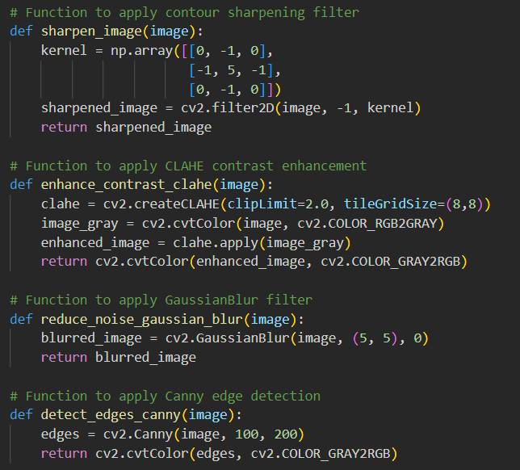
1. CLAHE (Contrast Limited Adaptive Histogram Equalization) method for improving the visibility of features in images that have varying lighting conditions.
2.Reduces noise using Gaussian Blur filtering.
3. Canny edge detector for detection of a wide range of edges in images and is used to delineate boundaries of objects within the image.

Slide 11
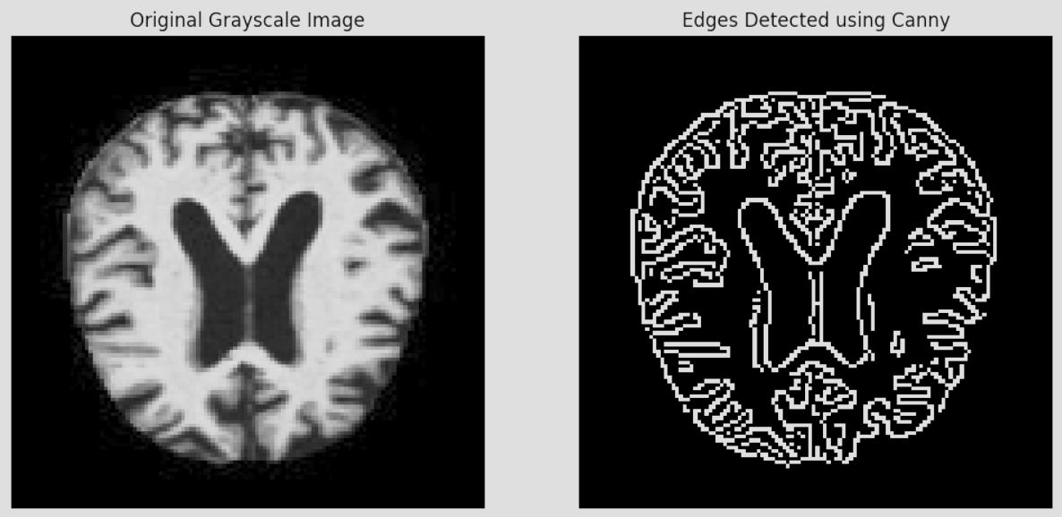
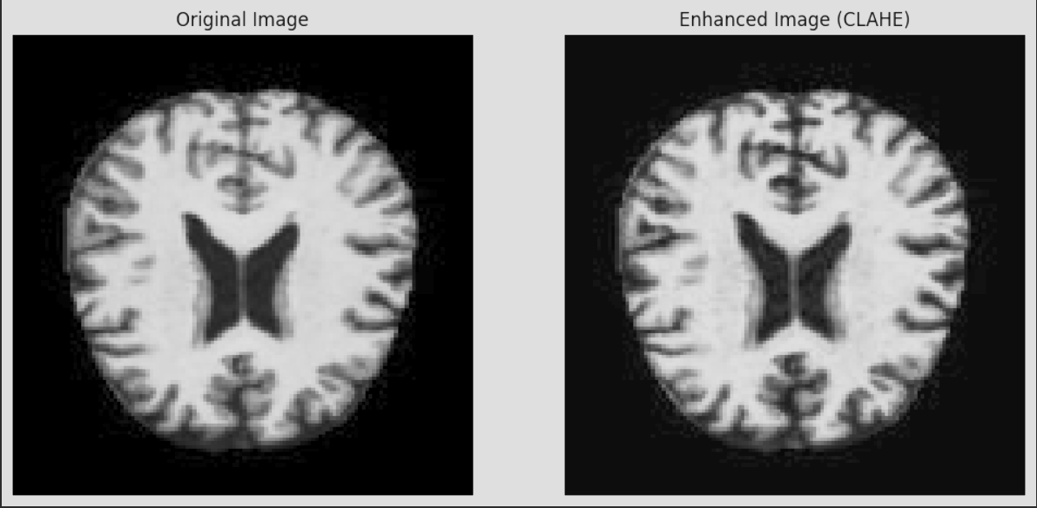
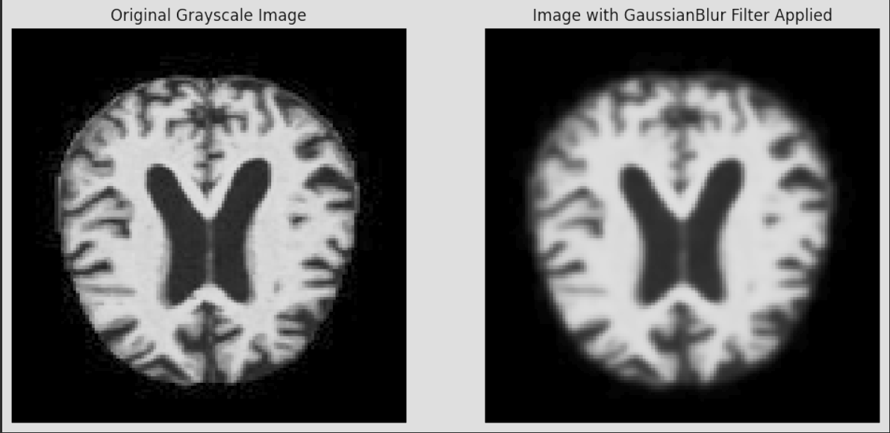

Slide 12
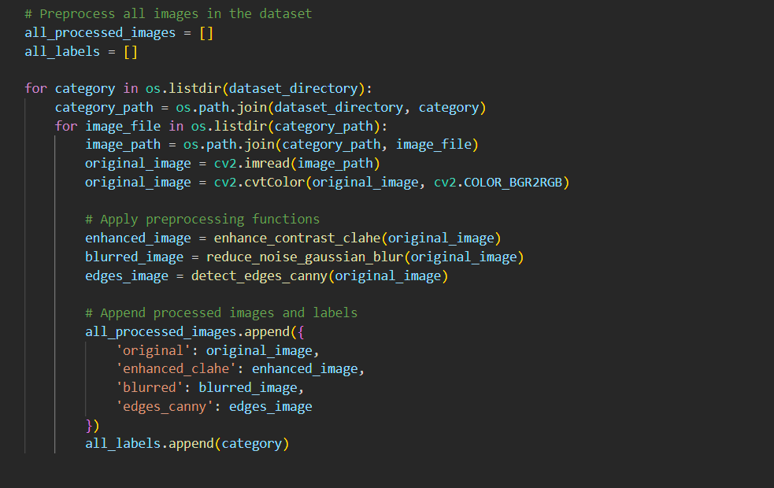

Slide 13

Data Preparation
Label Encoding
Handling Class Imbalance
Data Splitting
Data Normalization

Slide 14
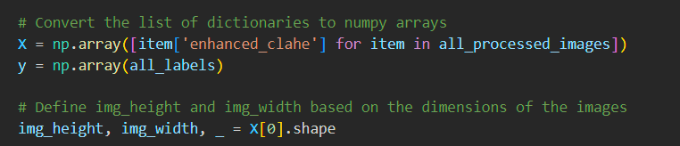
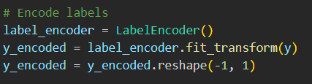
he dimensions of the images (img_height, img_width) based on the shape of the first image in the dataset.
Data Preparation:
X and y arrays are created from a list of dictionaries containing image data (specifically, images that have been enhanced using the CLAHE algorithm) and labels, respectively.
The dimensions of the images (img_height, img_width) based on the shape of the first image in the dataset.
Label Encoding:

Slide 15
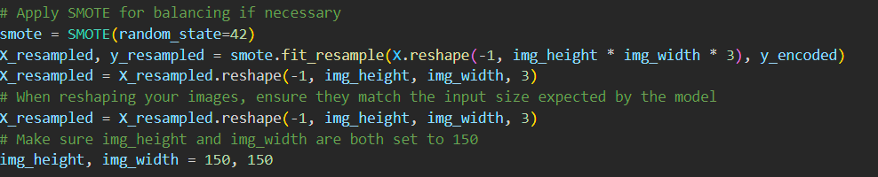
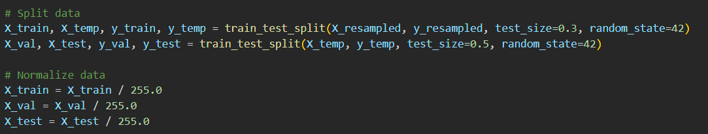
Handling Class Imbalance:
This involves resampling the original dataset to create a balanced set where each class has the same number of samples.
Reshaping: After resampling, the script reshapes the images to a standard format expected by the CNN model.
Data Splitting and Normalising the Data
1.The dataset is split into training, validation, and test sets, with 70% of the data used for training and the remainder equally divided between validation and testing.(15% validation, 15%test)
2.Pixel values, which can range from 0 to 255, are normalized by dividing by 255.0 so that they range from 0 to 1. This helps in speeding up the training process by scaling the input features to a similar range.

Slide 16
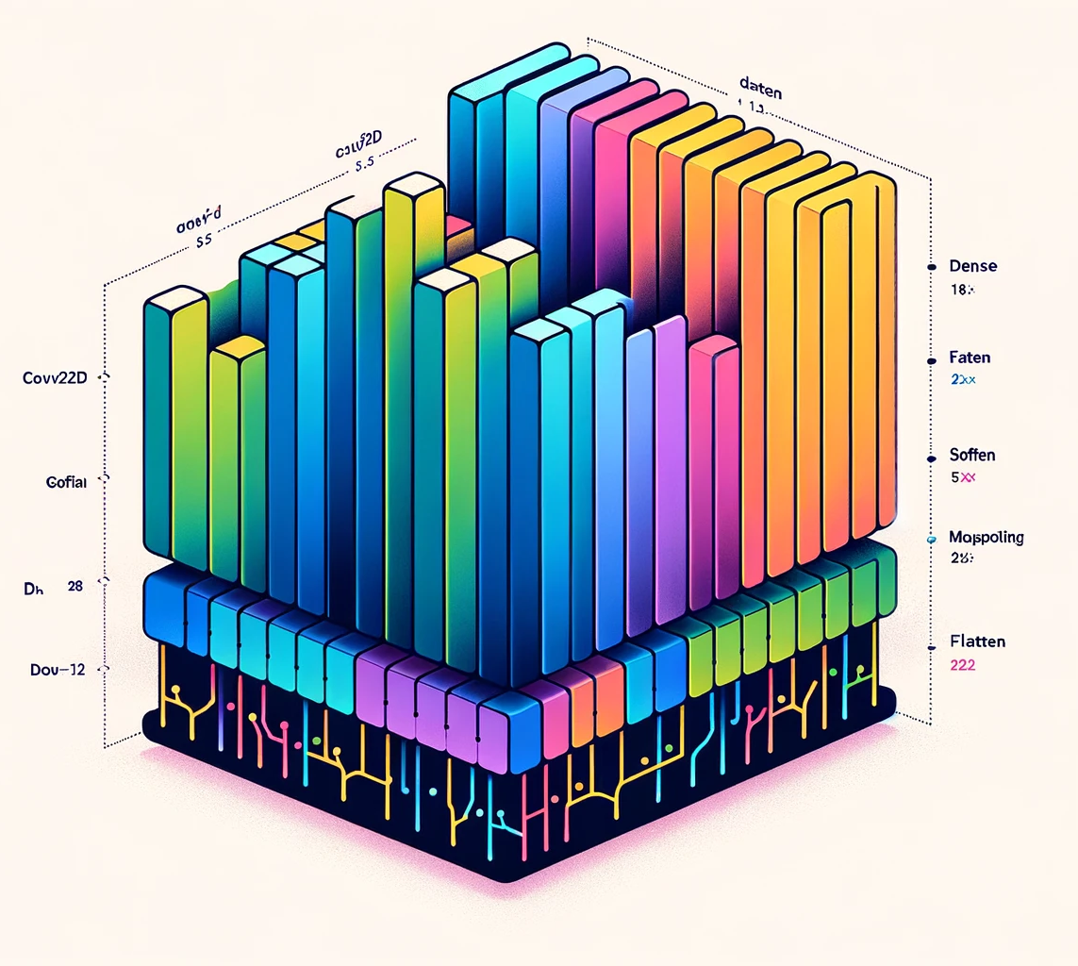
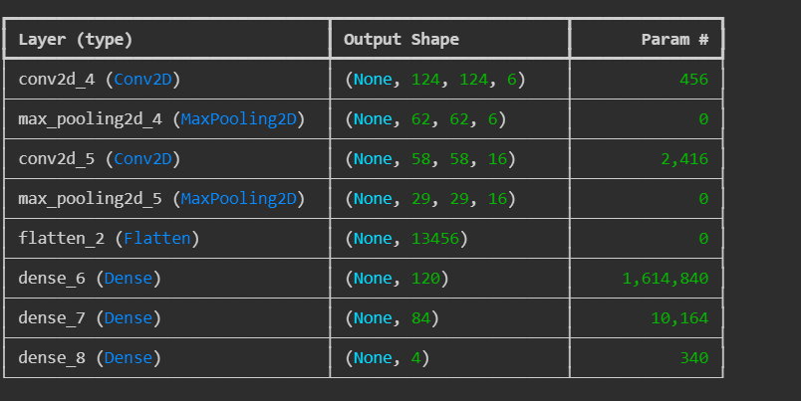
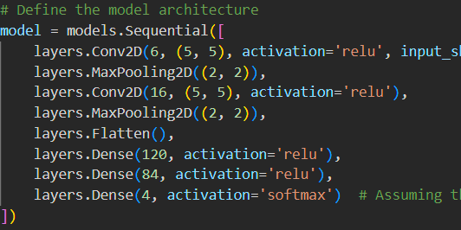
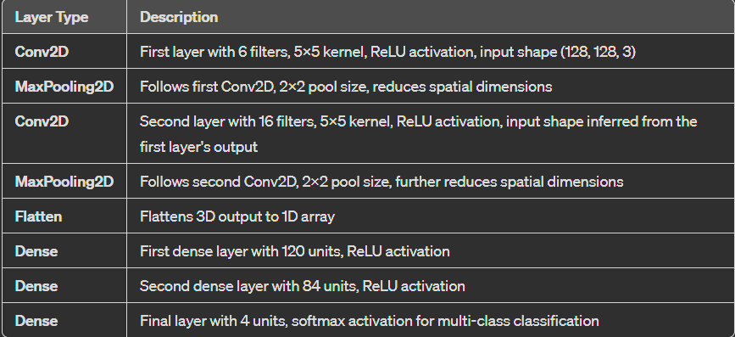
MODEL ACRCHITECTURE

Slide 17
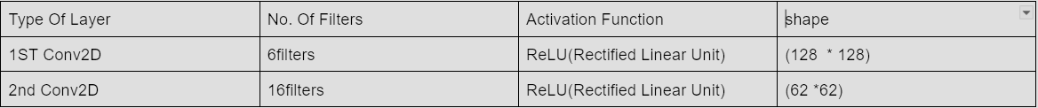
Function of Conv2D layer
They share same weights.
Detect features combining from the previous layer Have few parameters than fully connected layers.
Filters (that is 16 here) are increased more in the ConVD layer to compensate for reduction in spatial dimension and to increase the depth so that the network can learn more complex features.
Activation Function ReLU : Introduces non-linearity into the mode(learning more complex features) Simple and more efficient
Solves Vanishing Gradient

Slide 18

2 Max Pooling Layers :
Follows each ConV2D layer
Pool size – (2 *2)
Reduces Spatial Dimensions of the Input Layer
Reduces Overfitting
Flatten Layer:
This layer flattens the 3D output of the previous layers into a 1D array, making it possible to feed into a dense layer.
3 Dense Layers: Fully connected Layers
Function : Integration and interaction of features extracted from different parts of the input data.
1st - 120 units , Activation Function: ReLU
2nd – 84 Units, Activation Function: ReLU
3rd – 4Units, softmax activation function for multi-class classification

Slide 19
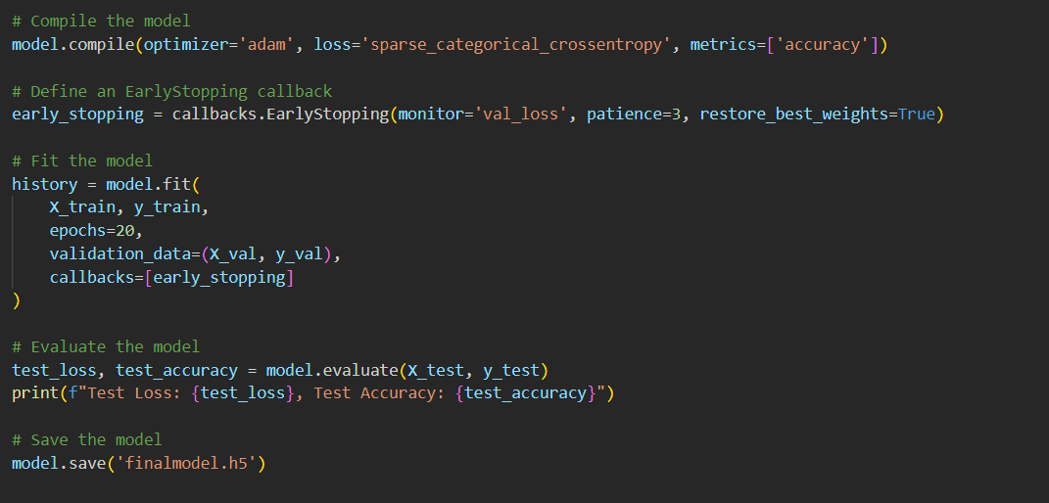
Optimiser Used : “Adam” Optimiser
loss='sparse_categorical_crossentropy’:
This is the loss function used when the target classes are integers; it measures the difference between the predicted probabilities and the actual class distribution.
Early Stopping Callback:
This callback monitors the validation loss ('val_loss'), and it will stop the training if the validation loss doesn't improve for 3 epochs (patience=3). After training is stopped, it restores the model weights from the epoch with the lowest validation loss (restore_best_weights=True).
Epochs:20

Slide 20
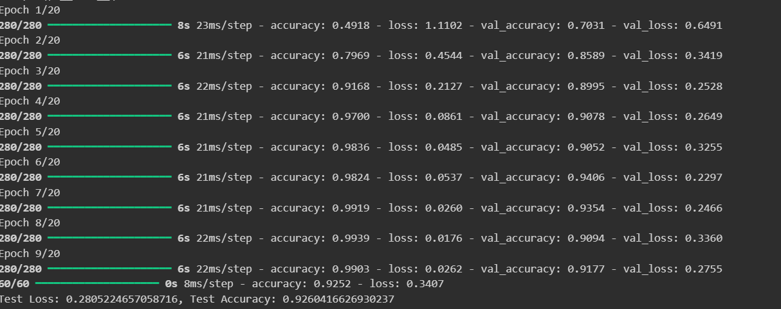
Training Accuracy: 99.39%
Test Accuracy:92.60%.
Test Loss: 0.2805224657058716
Overfitting seen
Future Works: Regularization, dropout, or data augmentation

Slide 21
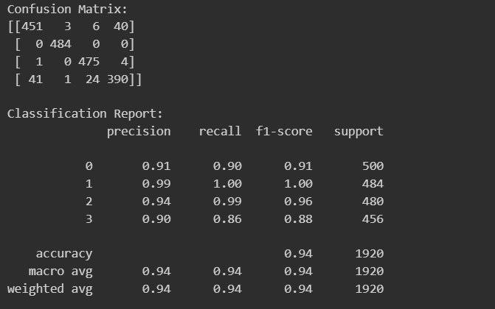
From this report, we can infer that the model performs very well across all classes with consistently high precision, recall, and F1 scores.
Class 1, in particular, shows perfect classification. Class 0 and 3 have higher misclassification rates, as evidenced by lower recall and F1-scores compared to class 1 and 2

Slide 22

THANK YOU

